Slide 1
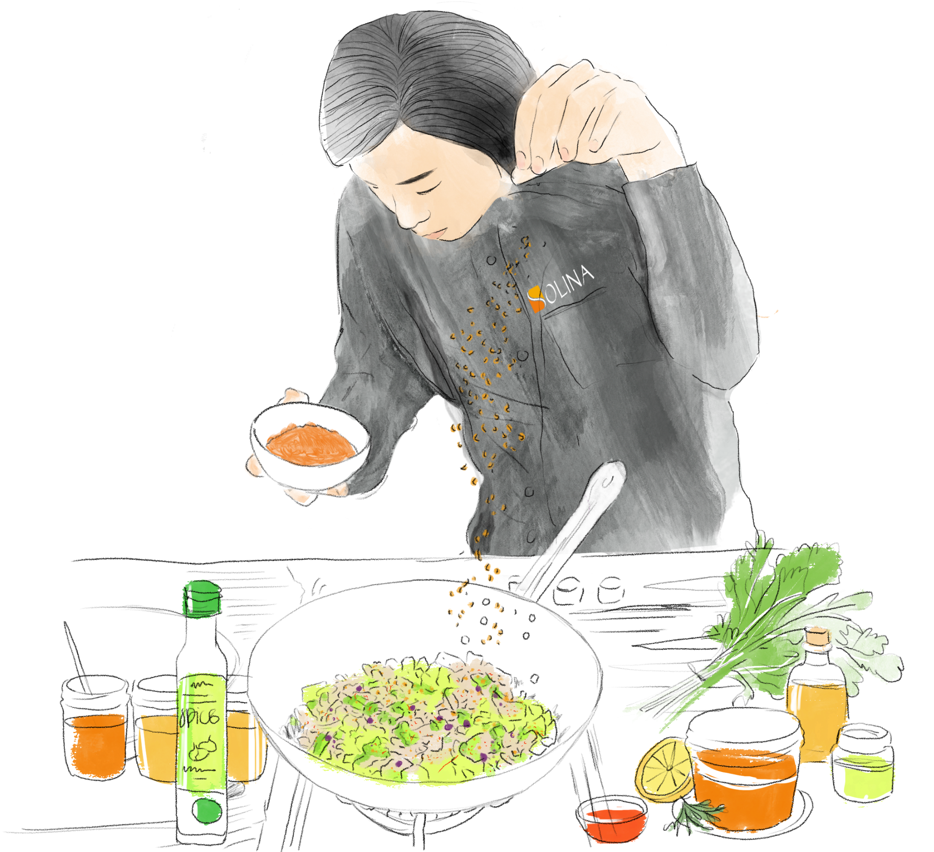
Solina Norway 2023
SFK Food A/S Part of Solina Group
Financial Year
01.01-31.12 2023
Aksomhets-vurdering
March 2024

Slide 2
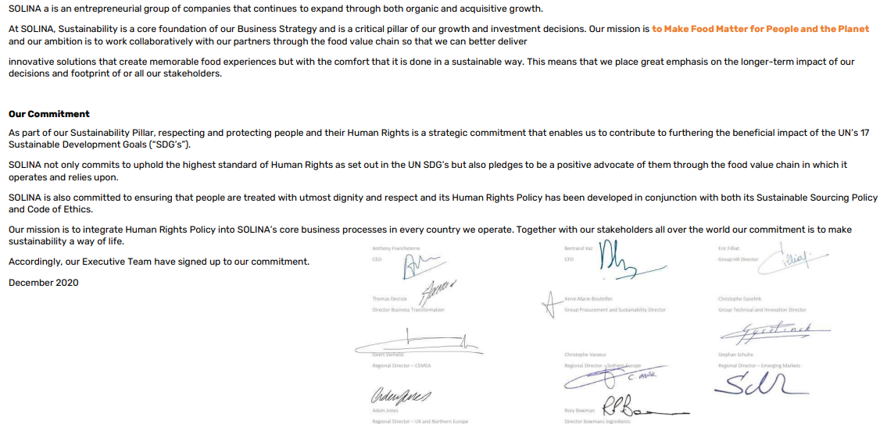
Solina Human Rights policy

Slide 3
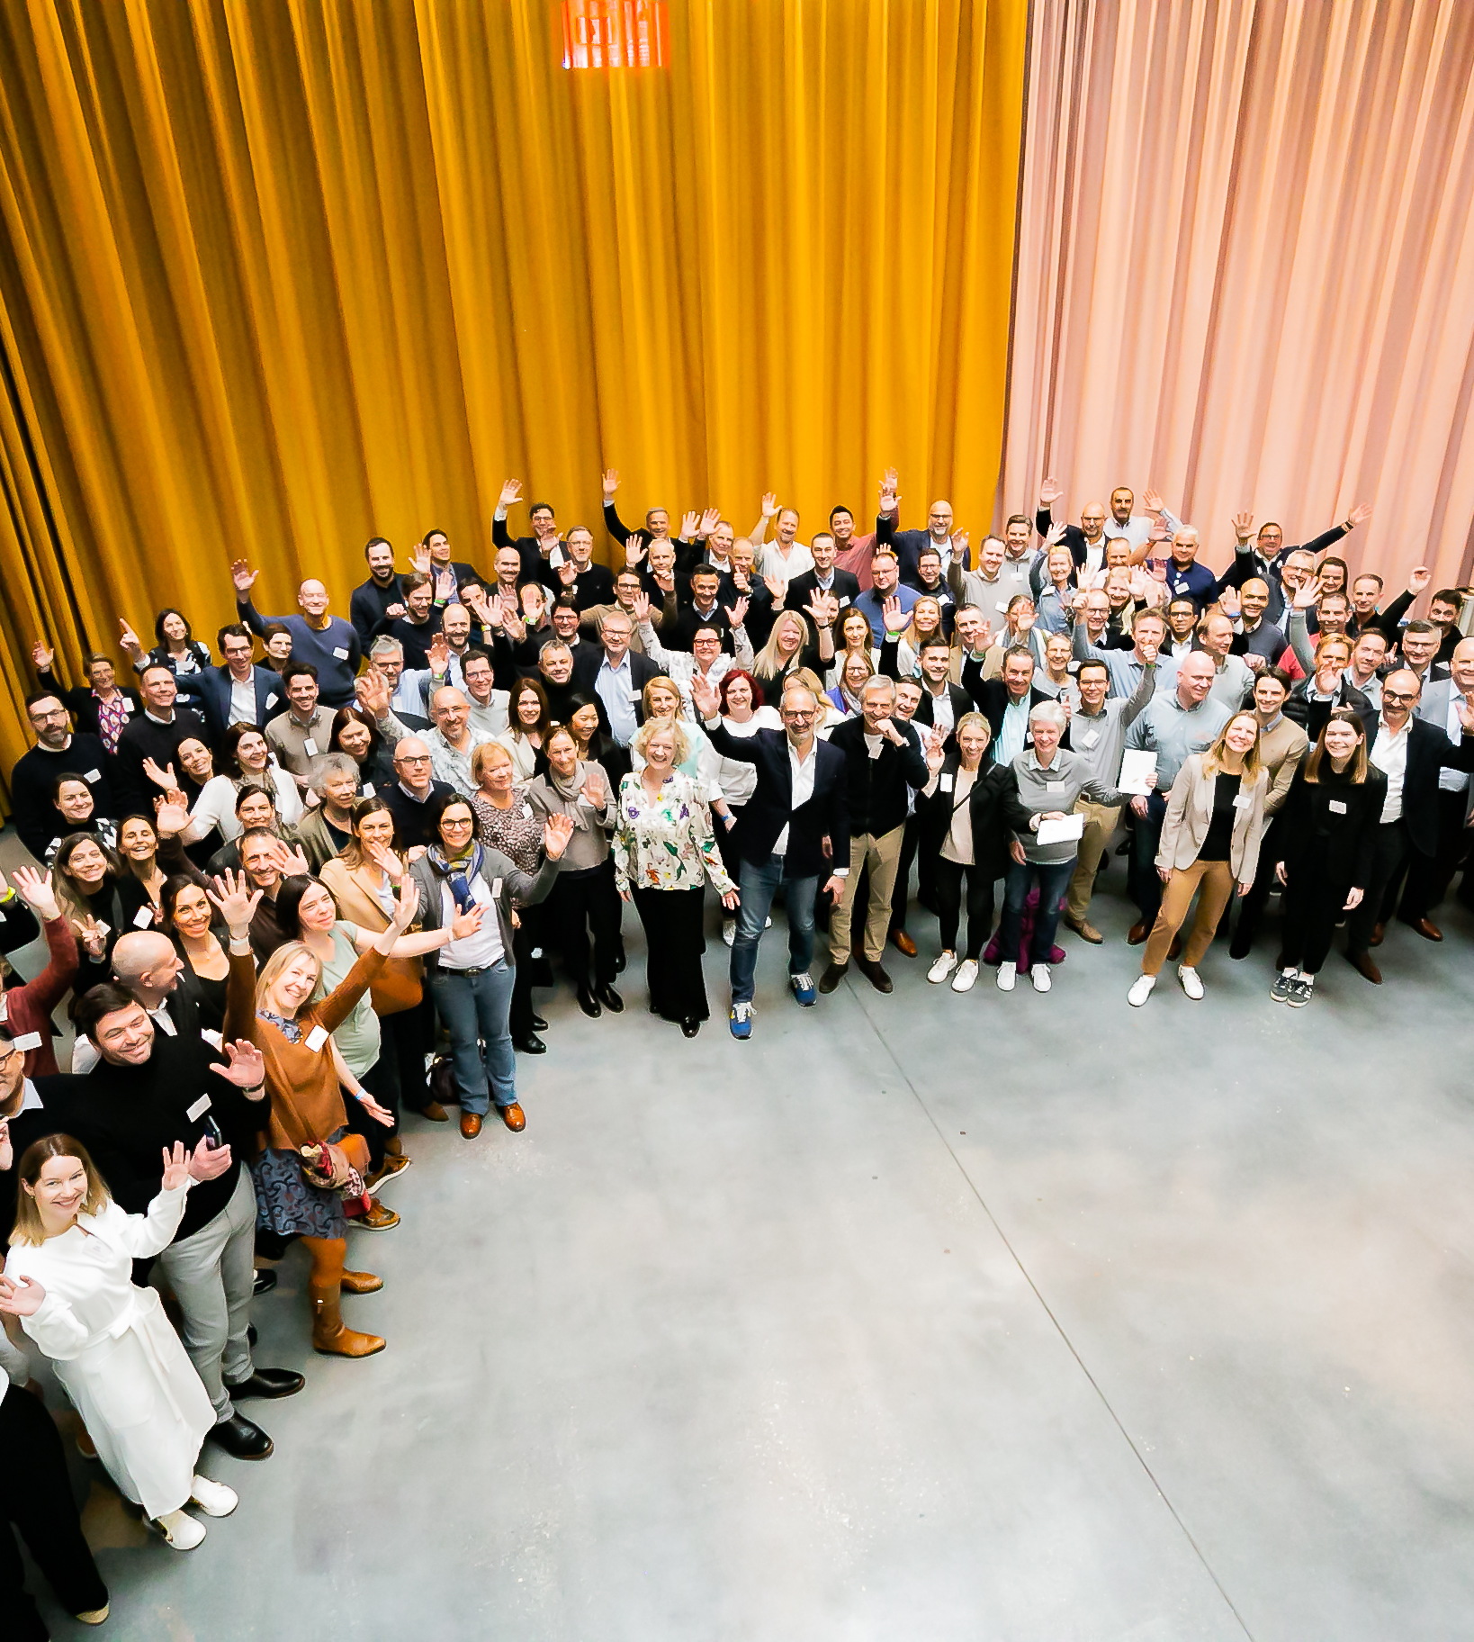
WHO
WE ARE

Slide 4
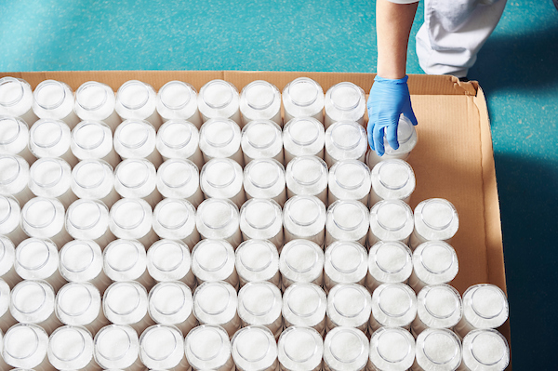
BUSINESS
1,2 B€ T/O
through organic growth and M&A
+ 75
countries
in which Solina has business activity
+ 18 000 customers
globally served by Solina
FACILITIES
18 countries
in which Solina has facility presence
+ 30 R&D centres
to rethink culinary food solutions
39 production sites
across Europe and North America
PEOPLE
+ 3.600 people
passionate about
food
> 10% R&D people
among all Solina colleagues
AA+ score
employee survey
Numbers speaking

Slide 5
7
39 factories in total
In North America
30
In Europe
1
37 production sites
2 logistic-only sites
Local proximity, global footprint.
JV in Africa (South-Africa)
1
JV in Asia
(Thailand)

Slide 6
Our Sustainability roadmap
Product Quality & Safety
Traceability
Corporate Transparency & Reporting
CSRD-reporting by 2026
2
100% compliance with product quality & safety standards
11
3
Consumer Health & Sustainable Solutions
Performance & Reporting
Sustainable Food System
1
Sustainable Packaging
Always include more sustainable solutions to customer-led innovations in a proactive approach
100% of our packaging to be recyclable or reusable, by 2025
Sustainable & Responsible Sourcing
100% insight-led innovations are healthier & more sustainable
50% sales from healthier & more sustainable alternatives
Increase the proportion of recycled plastics in our packaging by 2030
100% sustainable & traceable sourcing of our high-impact materials and strategic & preferred suppliers by 2030
Innovations & Solutions
5
6
10
Business Ethics & Integrity
GHG Emissions
Environmental impact
People & Culture
4
100% compliance with “Code of Ethics” from employees, suppliers & business partners*
Diversity, Equal Treatment & Inclusion
7
-25% of scope 3 GHG emissions by 2030
-42% of direct GHG emissions by 2030
45% women in leadership team*
8
9
Full women salary/bonus gender parity*
Talent Retention & Attraction
100% renewable energy by 2030
Operational Health, Safety & Wellbeing
90% talent retention*
0 accidents & occupational diseases culture*
* non-exhaustive list of targets

Slide 7
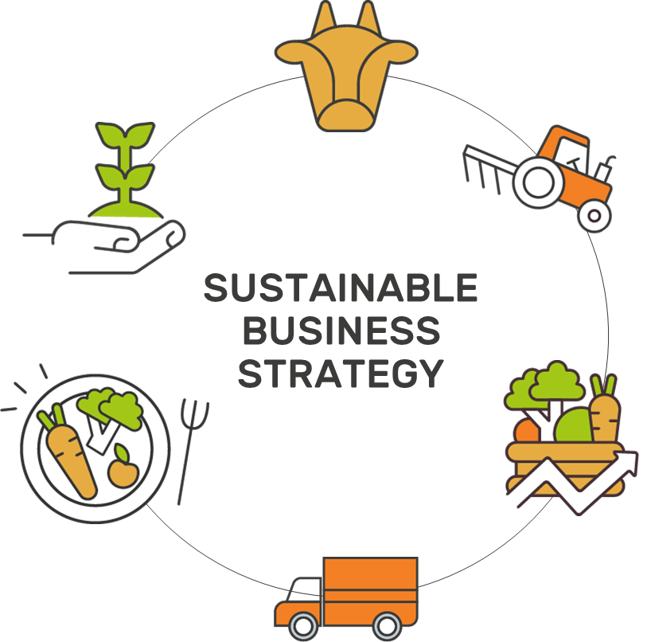
Innovations & Solutions
Environmental impact
Consumer Health & Sustainable Solutions
Sustainable packaging
100%
Of our insight-led innovations are healthier & more sustainable
100%
Of our packaging to be recyclable or reusable by 2025
-42%
Of scope 1 & 2 GHG emissions by 2030
2030 sustainability roadmap
To make food matter
for people and the planet
50%
Of our sales come from healthier & more sustainable alternatives
Increase the proportion of recycled plastics in our packaging by 2030
-25%
Of scope 3 GHG emissions by 2030
Always
Include more sustainable solutions to customer-led innovations in a proactive approach
100%
Renewable energy by 2030
Sustainable Food System
Performance & Reporting
Sustainable & Responsible Sourcing & Traceability
Corporate Transparency & Reporting
100%
Sustainable & traceable sourcing of our high-impact materials and strategic & preferred suppliers by 2030
Fully transparent ESG reporting by 2026 in line with CSRD
Product Quality & Safety
100%
Compliance with product quality & safety standards
People & Culture
Diversity, Equal Treatment & Inclusion
45%
Women in
leadership team
Talent Retention & Attraction
90%
Talent retention
Operational Health, Safety & Wellbeing
ZERO
Accidents & occupational
diseases culture
Business Ethics & Integrity
100%
Compliance with “Code of Ethics” for employees, suppliers & business partners

Slide 8
Company profile - Norway
Solina Norway, part of Solina Group, is a food producing and trading company situated in Norway and has been selling primarily ingredients, utensils, packing materials to the food industry.
Our production handles of more than 300 blends
In 2023 we produced 112 tonnes spices and blends
In 2023 Solina Norway employed 7 people
In 2023 the plant expanded from 700 m2 till 1700 m2
In 2023 we added a new production line
We put an effort into making a safe and healthy work environment, and to produce responsible and sustainable products with as little impact on the environment as possible.
Being part of Solina Group strengthens our position worldwide with a broader knowledge of the market and giving better possibilities to work with suppliers on issues like social responsibility and environmental behavior.

Slide 9
Certificates
Solina Norway is about to be certified by BRCGS Start! in spring 2024. In the following years, the goal is to be certified by BRC Food, ISO 45001 and ISO 14001.

Slide 10
Working responsibly
Solina Norway recognizes the importance of ensuring both product quality and the conditions under which the products haveemerged. This entails requirements for ethical, social and environmental conditions for Solina Norway as well as for our suppliers.
It is the company strategy to work actively with issues related to ESG. Environment, sustainability and Health & Safety are integral part of day-to-day work. In our daily work we put an effort into approaching the Sustainability Development Goal 12 - Responsible consumption and production. Also, the principles 1-2 Human Rights and 3-6 Labor Principles affects the daily work. This applies to comply with applicable Norwegian Legislation on the work environment and according to the goal achieving certification in ISO 45001.
Sick Leave
There was a total of 27 sick days – 1,7 % in 2023.
Risks
Not complying working with the principles and the Norwegian Legislation, will have the consequences that employees will not experience wellbeing while working at the company, and due to that, terminate the employment relationship. Also, this will have a negative effect on the company's reputation and by that reduce sale and work with business partners.

Slide 11
Products and suppliers
Products
The market for new products based on vegetables is rising, and we have a well assorted selection of vegetables products, for making it easy for our costumers to make sustainable choices and to affect the reduction of CO2.
Suppliers
Being a part of Solina Group is a possibility to work and affect our suppliers in a more extensive manner to perform on the UN global 10 statements. All suppliers must fill out a questionnaire in our SRM Portal Solina Connect which involves questions about sustainability. Solina Group is increasing the focus on sustainability and a 2024 aim, is that at least 60% of the suppliers is a member of a social organization (ex Ecovadis or Sedex). Also Solina Group has implemented the principles on Human Rights in our Code of Conduct.

Slide 12
What is to come in 2024
Health and safety
Solina Group has decided to use an online based report system for accidents, near miss and risky situations. The system can handle reports and action plans and it is possible to assign tasks to colleagues due to follow up. All employees has access to the system.The overall purpose for the system is to handle all actions and prevent accidents to improve the overall work environment.
Production
It is the expectation that the productivity will increase till a total of 500-700 tons after being certified with the BRCGS Start!. Because of this increase, it is the expectation that the number of employees will be 10-12 persons.

Slide 13
“
The greatest threat to our planet is the belief that someone else will save it
“

Slide 14
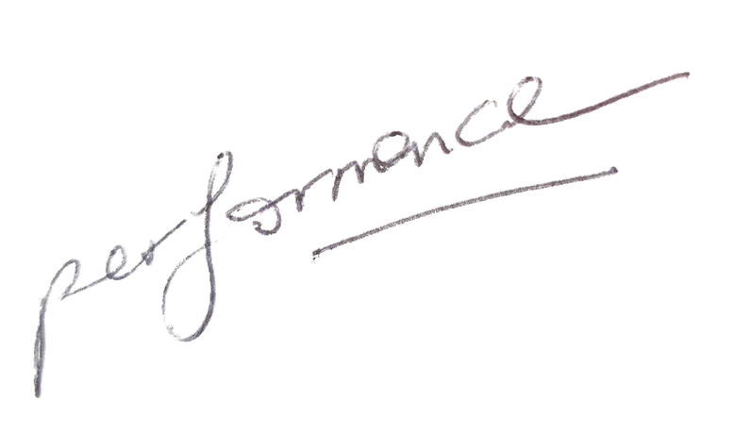
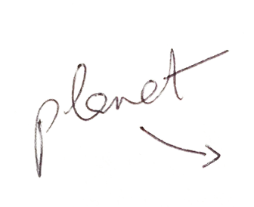
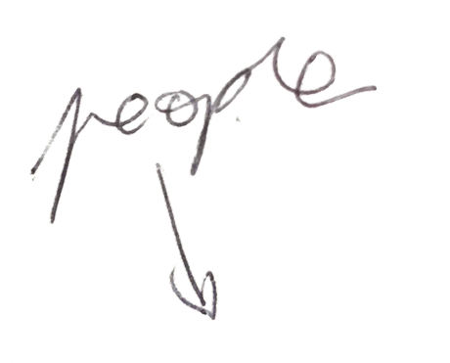
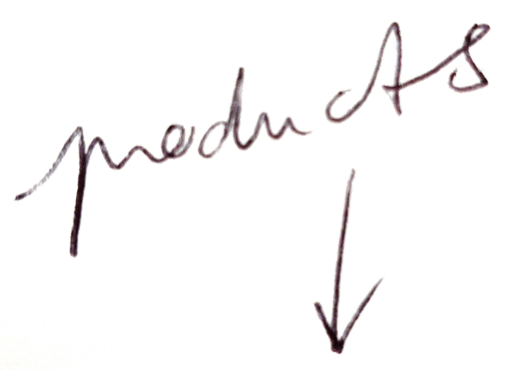
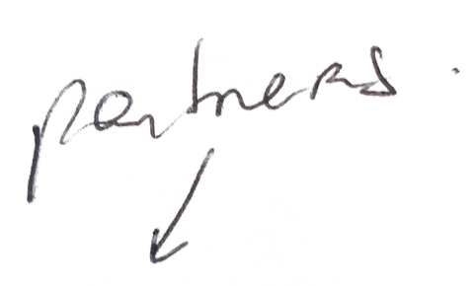
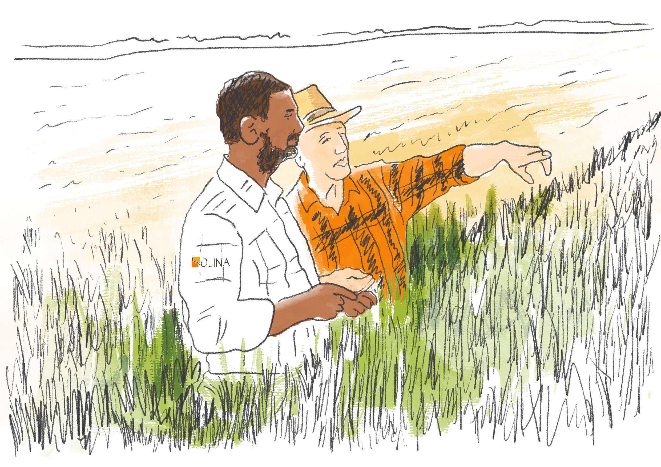
Sustainability at heart
Because we have to..
But most importantly because We want to.
As Solina we want to take responsibility for the impact we have – on the full value chain – From Farm to Fork

